Slide 1


Using Arcade in your ArcGIS API for JavaScript Apps
Kristian Ekenes and David Bayer
Notes:
[dave]
Introduction

Slide 2
Session Goals
Overview of Arcade
What is Arcade
Why use Arcade
Arcade and the ESRI JavaScript API
Using Arcade in Custom Apps
Notes:
In this session, we are going to give an Overview of Arcade… What it is, and why you would want to use it.
We are going to look at the language, and then lastly look at how you can use it in your own Apps, written in JavaScript.
Now Lets get into the really important questions. These are the questions we are most commonly asked about Arcade

Slide 3
A new expression language for the ArcGIS Platform
ArcGIS Pro
Runtime SDKs
JavaScript API
Web apps
Primarily designed for ArcGIS web maps and web scenes
What is Arcade?
Notes:
Explain …..
-> History of calling Languages After Street Furniture -> Avenue
-> UK Connection… One of the Development Teams was in Wales
-> Arcade a Smaller, Safer Shopping Street
-> Seemed to Work… We did consider other names… Boulevard, Roundabout

Slide 4
Arcade Purpose
Arcade is NOT intended to be a Full Programming / Scripting Language
Goal : Lightweight and Simple
Equivalent to a Spreadsheet Cell Calculation
Embedded Expressions
Labeling, Rendering, Symbol Variation, ….
Sharing
Not a replacement for Python for geoprocessing and Automation
Input Values
Arcade
Expression
Result Value
Notes:
This is why we have developed Arcade… Not as a Full Programming or Scripting Language, but as a Simple Expression Language.
Equivalent to an Excel Spreadsheet calculation.
It is simply intended to take input values, evaluate them, and return a result value.

Slide 5
Hello World
And a few more examples…
Notes:
Playground – Hello World
ArcGIsOnline Map -> Showcase Maps with Renderers, and Labelling → Really Simple Ones
ArcGIs Pro Demo -> Showing a Map, Published to ArcGis Online → Really Simple Ones

Slide 6


Why is it called Arcade?
Notes:
Explain …..
-> History of calling Languages After Types of Street-> Avenue
-> UK Connection… One of the Development Teams was in Wales
-> We did not want to call it Roundabout, thought it might set the wrong impression.
-> Arcade a Smaller, Safer Shopping Street
-> Seemed to Work… We did consider other names… Boulevard

Slide 7
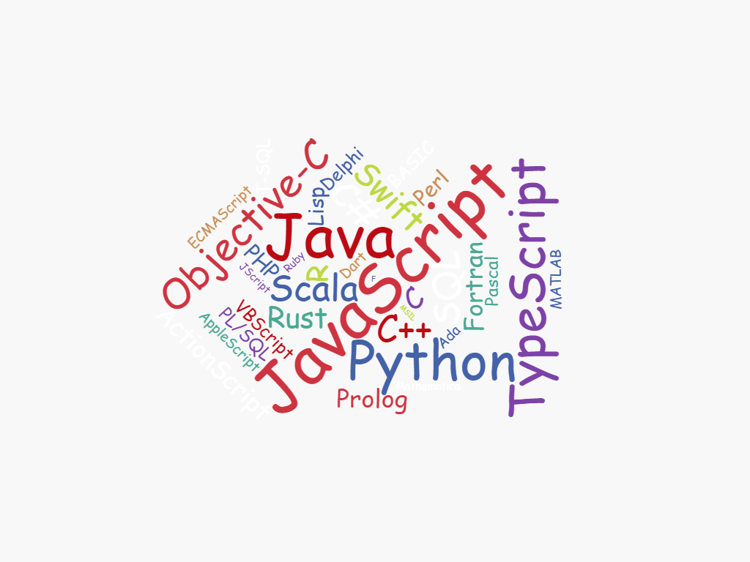
Why do I need another language?
Notes:
This is a question… We are asked a lot……..
Why another language, there are so many to choose from..
We put a lot of thought into why we were writing Arcade, and the problem it is solving… As we go through the talk… you will hopefully see why we have gone down this route, and see the gap it is trying to plug.

Slide 8
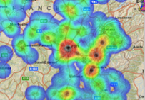
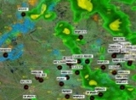
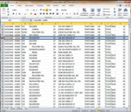
ArcGIS: Make, Share, Anywhere
Notes:
The reason this is a gap, is because we want publish and share maps and analysis.
If we have customised those maps with logic written in Python, or JavaScript, it becomes difficult to share the map, and use it in all the places you want to have access to the map

Slide 9


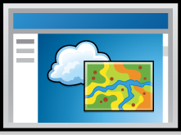
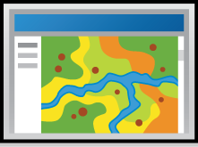
ArcGIS Environments and Platforms
Smart Phones
Social Media
Tablets
Web Sites
Desktop
Browsers
Notes:
Another view of all of these different Apps, is to look at all the different Environments that the ArcGIS Platform runs on
It runs on Desktop, Tablets, Phones, Embedded in Social Media, as WebSites

Slide 10



ArcGIS: Make, Share, Anywhere - Challenges
Traditional Development / Scripting Languages
Browser based Apps
Mobile and Native Apps
Size of Executable
Security
Native Access
Page Size
Security
XSS
No Binaries
Notes:
There is often the question, why you cannot just shared the customised logic..
Say you have written a labelling expression in Python in ArcGIS Pro… why can you just not include python on mobile devices, or the JavaScript engine..
The problem is twofold, adding as an extensive engine as Python or JavaScript is very sizeable, for resource constrained devices.
And Secondly, more important… Security.. Scripts written in JavaScript or Python can do anything… Which means you need to somehow run them in a sandbox, or similar.
For Browser based applications… They only run JavaScript, so your python script will not work… Or you will have network latency to run the python on the server…
Also security, running JavaScript is not going to be very accecptable to Sys Admins.

Slide 11
Arcade Goals
Portable
Write an Expression in Pro, have it run in a Browser, or on a Device
Secure
Ensure that Expressions or Scripting do not compromise Security
Lightweight
Most requirements for Scripts and Expressions are Lightweight. The language should be small, and fast
Geospatial
Scripts should treat Geospatial as First Class Members
Notes:
The goals of Arcade are as follows.

Slide 12
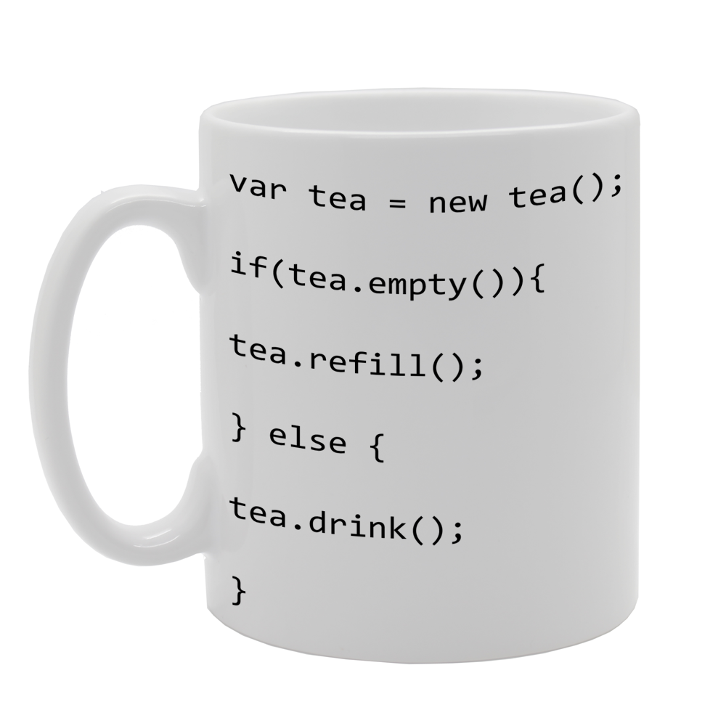
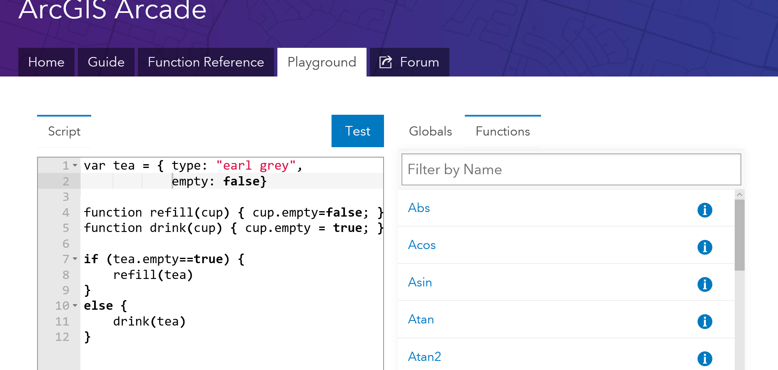
What can I do with it?
Notes:
The final question is….
As an example, I thought I would take the classic tea problem, and write it in Arcade.
Again, as we go through the talk, will give an answer to this.

Slide 13
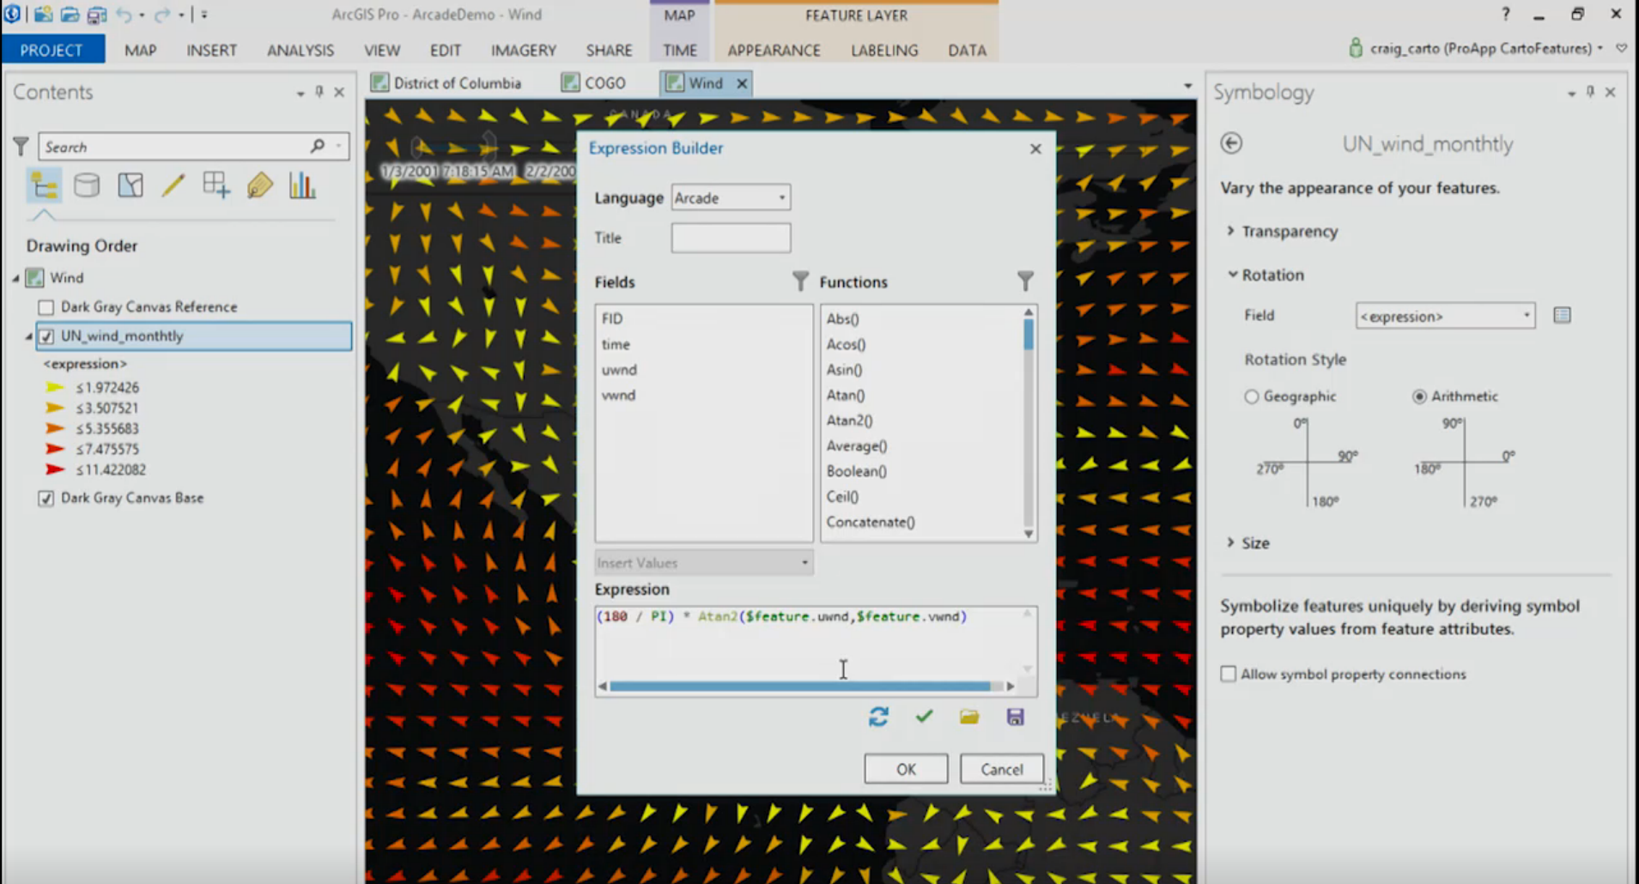
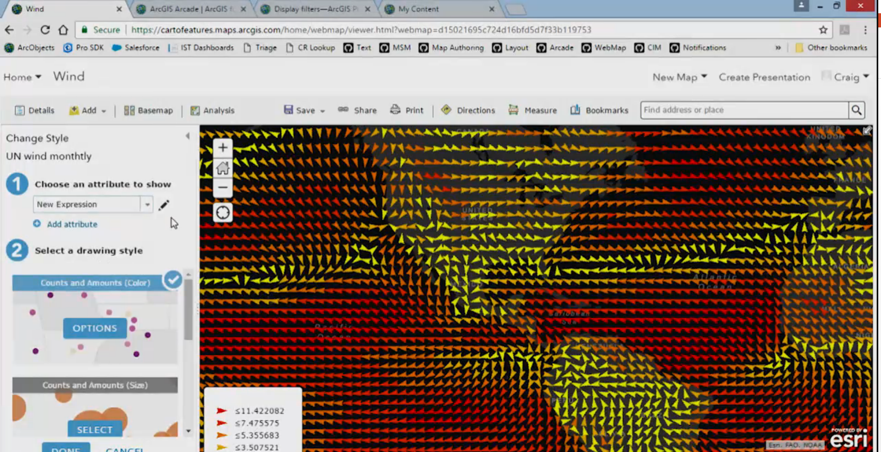
Arcade Examples
Notes:
Playground – Hello World
ArcGIsOnline Map -> Showcase Maps with Renderers, and Labelling → Really Simple Ones
ArcGIs Pro Demo -> Showing a Map, Published to ArcGis Online → Really Simple Ones

Slide 14

Global Variables and Profiles
Labeling
Rendering
Use Expressions to provide values required for different types of Renderers
Global Variables
$feature
$view
Use Expressions to provide values required for different types of Renderers
Global Variables
$feature
$view
Future Profiles
“
Profiles provide the purpose for executing an Arcade Expression
Notes:
Whilst Arcade is a Language, it is not tied to any particular workflow. It is simply passed input variables (as globals), runs, and return output variables.
We have the concept of a Profile, which determines why the Script is being run, and what globals it will have available.

Slide 15
Arcade Playground
Type System
Flow Control
Statements
Functions
Statements
and Operators
Notes:
OK… Hopefully you can see why we have written Arcade.
We are now going to go into the Language a Bit. So you can see how we have tried to reach the goals of simplicity and ease of use, but also so you can see how to achieve common tasks.

Slide 16

Arcade and the ESRI JS API
ESRI JS API
Version 3.19
ESRI JS API
Version 4.2
Arcade
Arcade
Inside
Inside
“
Arcade Interpreter available in both 3.19 and 4.2 JavaScript API
Notes:
So the last part of the talk, is to look at using the Arcade Compiler inside your own Apps written in JavaScript.
It is important to state the Arcade, works in Pro. It is available as a C++ engine, and a JavaScript engine

Slide 17
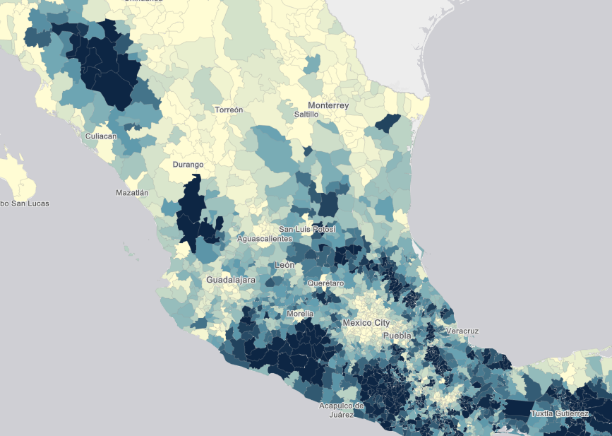
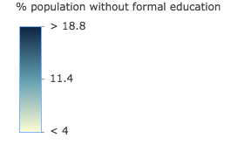
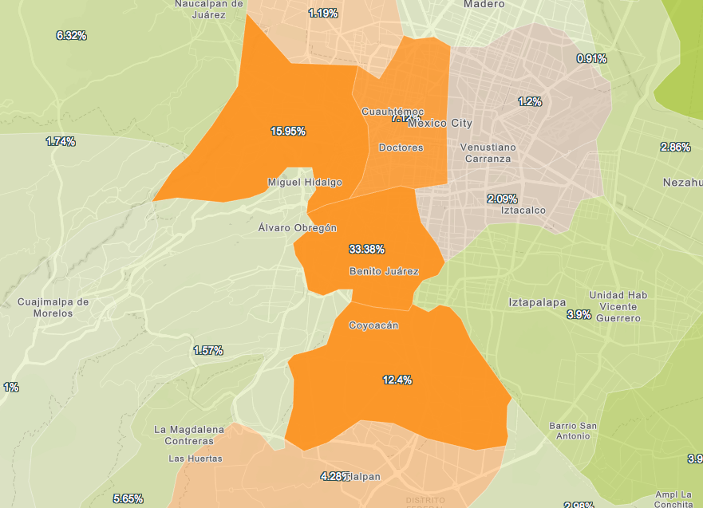
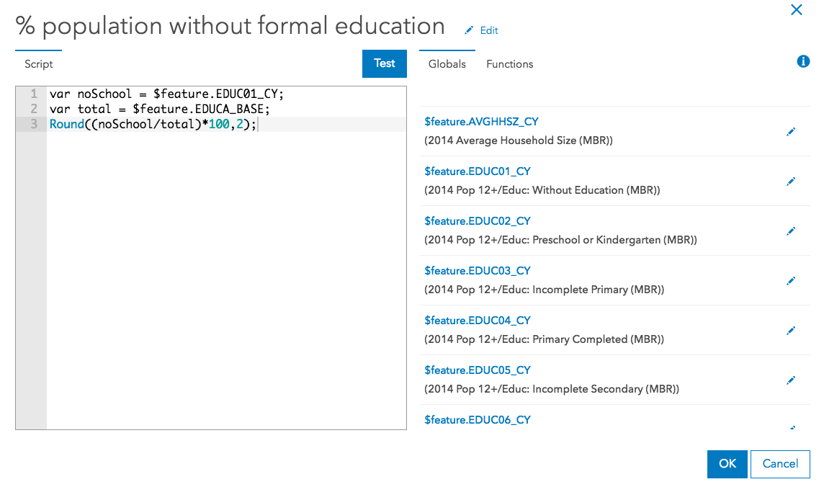
Demos
Notes:
[KRISTIAN]
Now you have seen the language….
Implicit Return one
Lets look at more Complex Examples

Slide 18
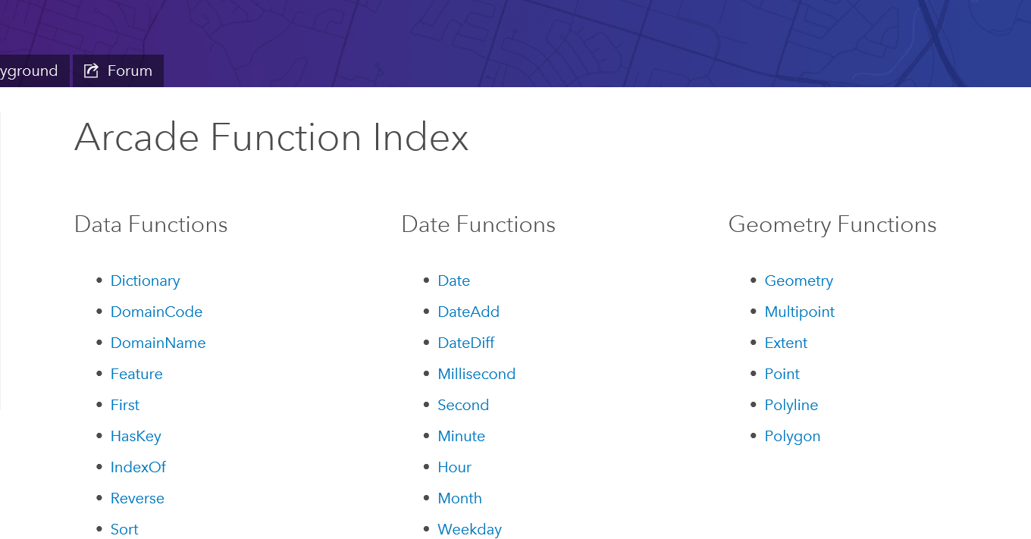
Adding Functions
Identifying Common Operations
Let us know what you need!
Notes:
We want to added more functions, to make Arcade more powerful

Slide 19
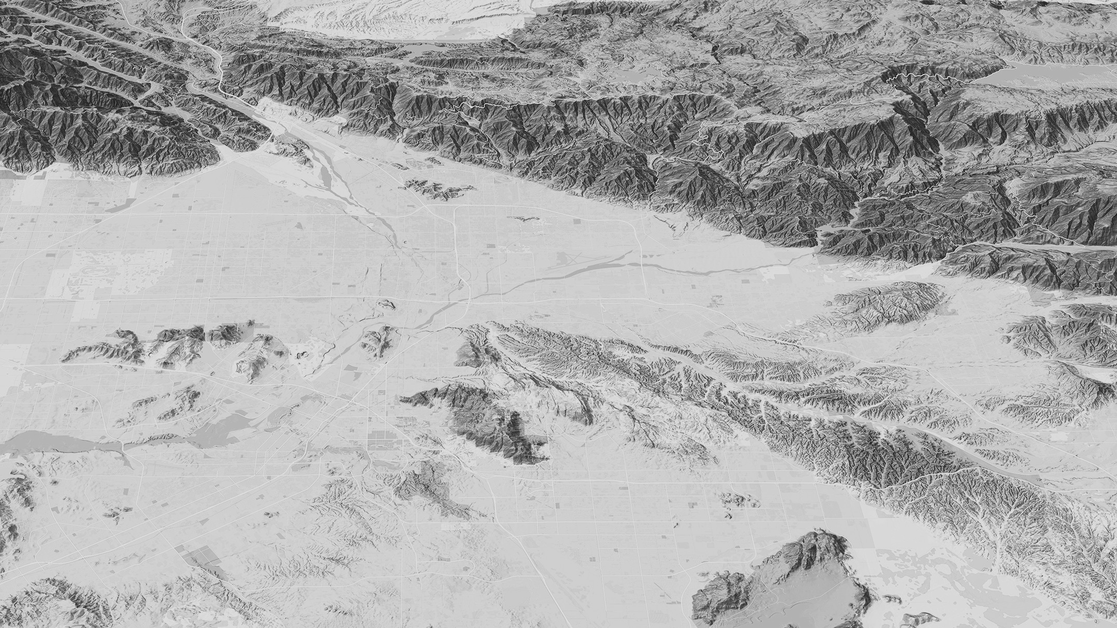

Finding Arcade Resources
Notes:
A big headache with any language or script expression.. Whether it is an Excel Formula, ActionScript, JavaScript or C# is where to find resources.
We have spent a bit of time putting together the help for Arcade online

Slide 20
Resources
For Arcade Documentation
https://developers.arcgis.com/arcade
Playground https://developers.arcgis.com/arcade/playground/
Using Arcade with JS API
https://developers.arcgis.com/javascript/latest/guide/arcade/index.html
Blogs and Posts https://blogs.esri.com/esri/arcgis/2016/12/19/introducing-arcade/
https://blogs.esri.com/esri/arcgis/2016/12/15/use-arcade-expressions-to-map-your-ideas/
http://odoe.net/blog/hello-arcade/
https://blogs.esri.com/esri/arcgis/2017/01/10/using-arcade-expressions-in-web-apps/

Slide 21
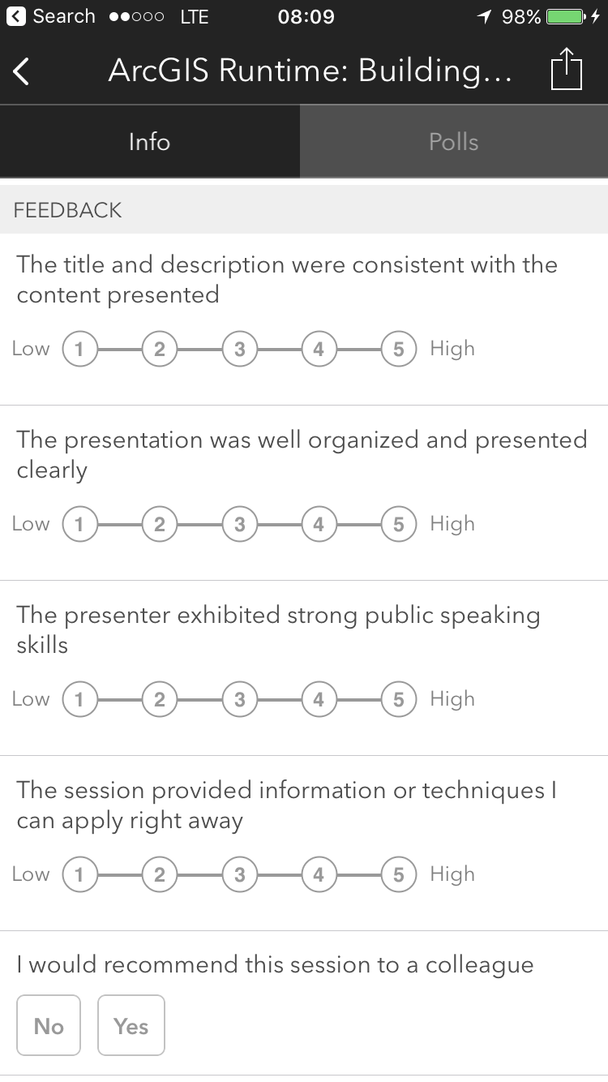
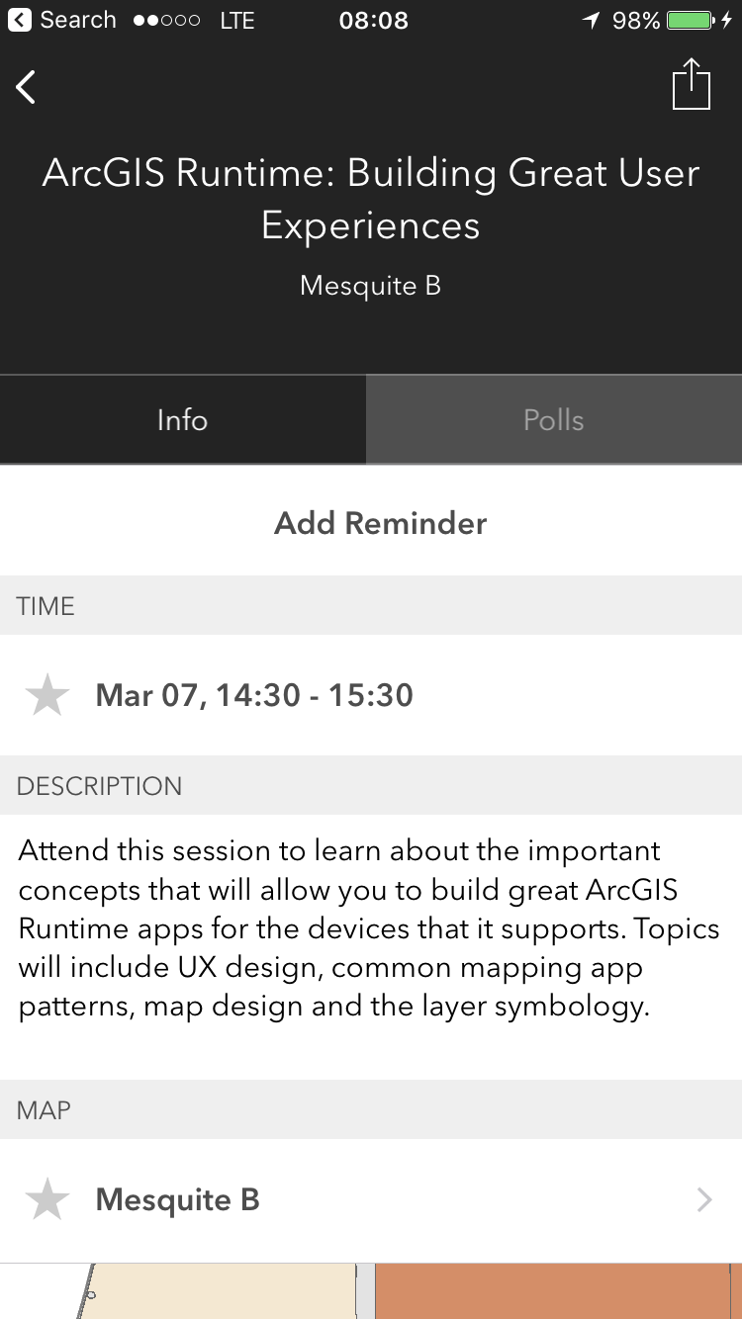
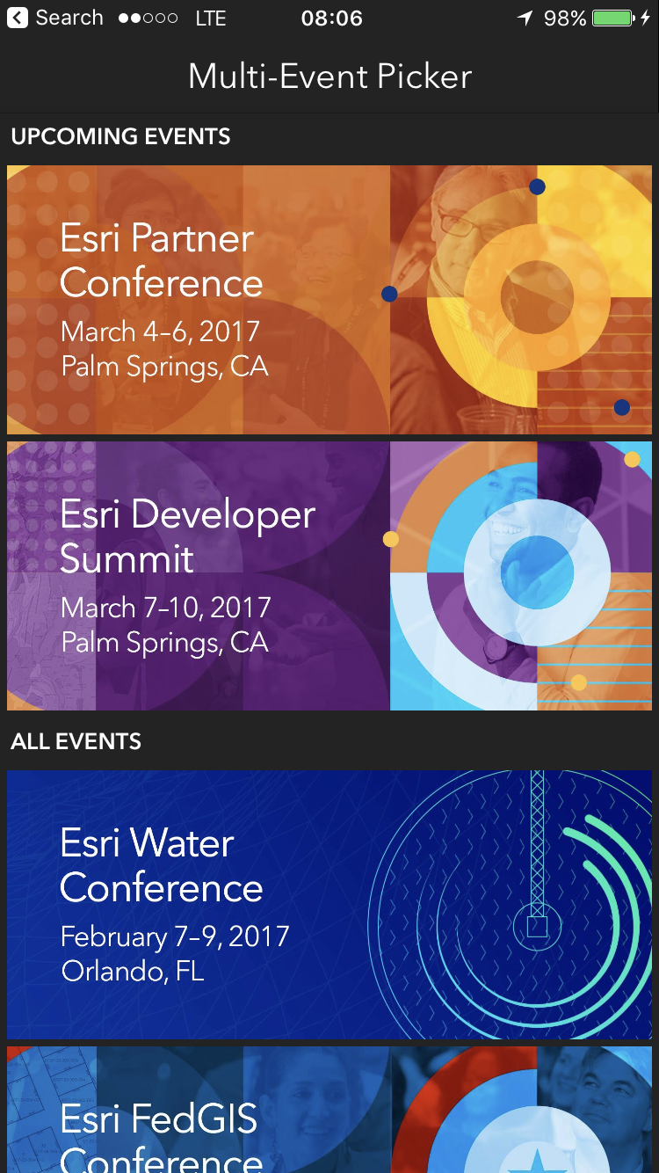
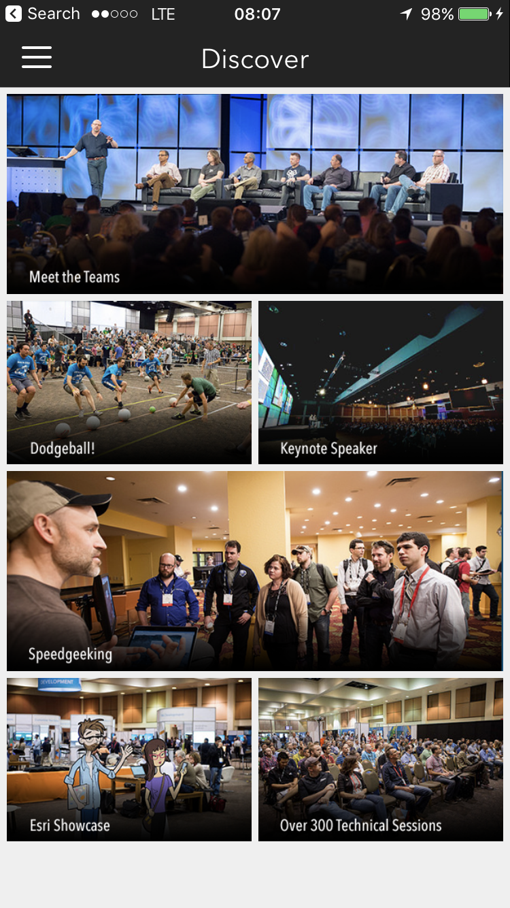
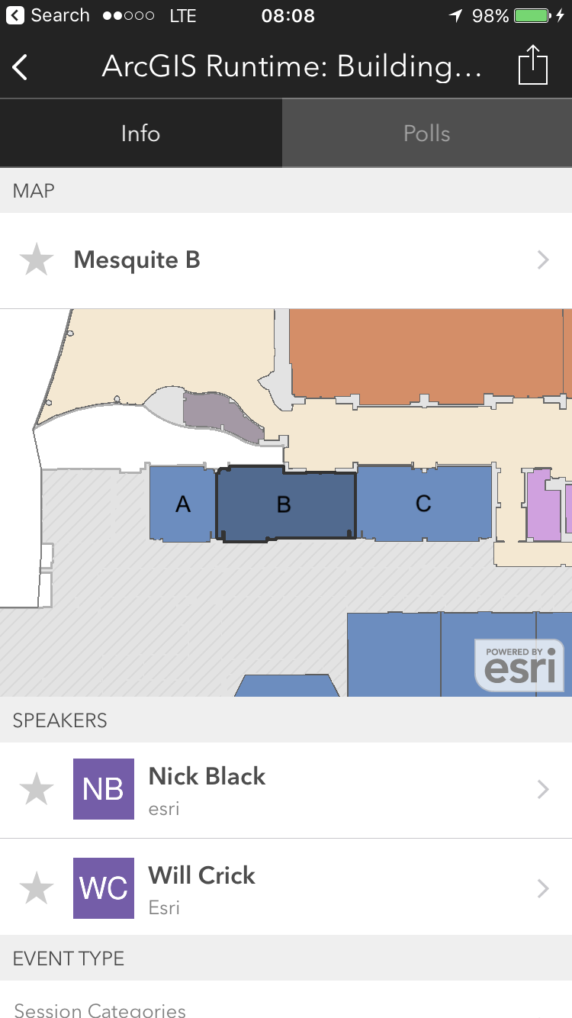
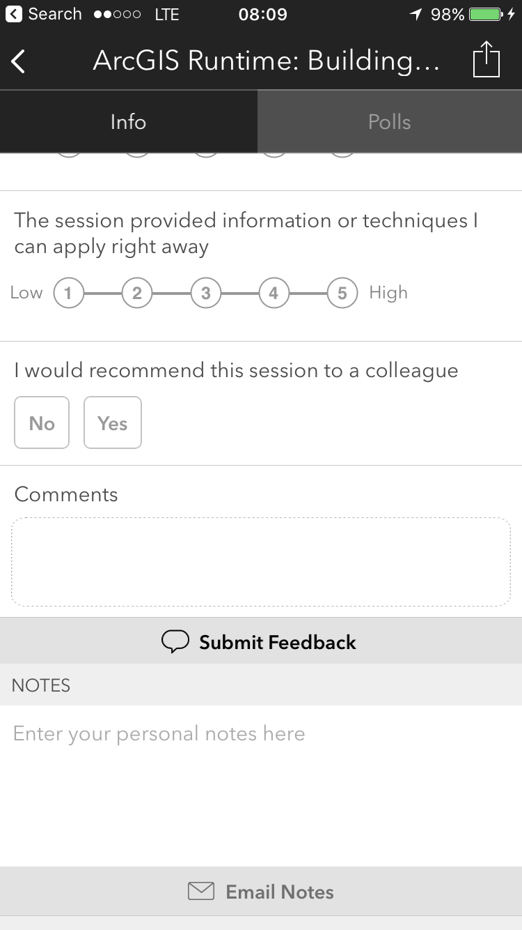
Please Take Our Survey!
Scroll down to the
“Feedback” section
Download the Esri Events app
and go to DevSummit
Select the session you attended
Complete Answers,
add a Comment,
and Select “Submit”

